Slide 1

Bank Loan Insights Dashboard
Visualizing Trends in Loan Approvals and Risk Factors
Presented by: Hetavi Patel

Slide 2

Project Overview
Goal
Data Source
Analyze loan data to reveal approval trends and risk factors.
financial_loan.csv dataset from bank records.
Platform
Dashboard developed using Power BI for dynamic visualization.

Slide 3
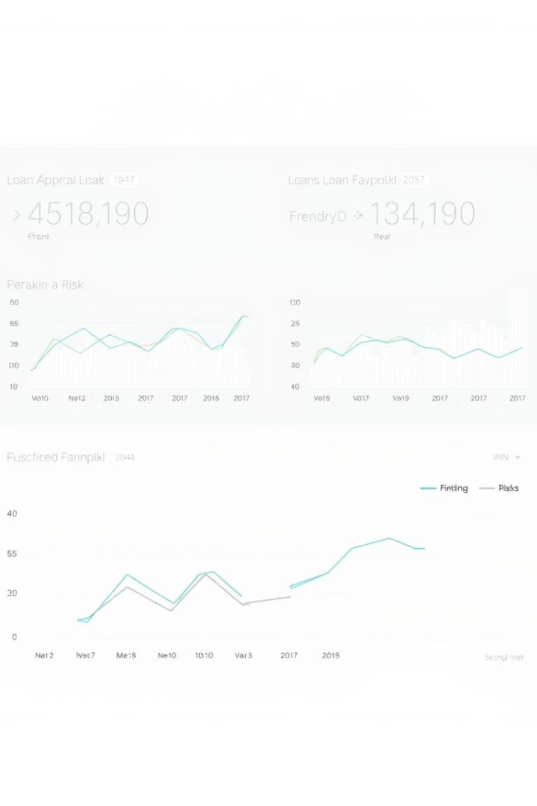
Objectives
Evaluate Approval Patterns
Identify Risk Factors
Spot key applicant traits linked to higher loan risks.
Understand factors behind loan approvals and denials.
Visualize Distributions
Analyze loans by geography, income levels, and purposes.

Slide 4

Data Preparation Process
Create Metrics
Standardize Columns
Calculated approval ratios and risk indicators.
Clean Data
Normalized fields like loan status and purpose.
Removed missing and duplicate records for accuracy.

Slide 5
Key Dashboard Visuals
Loan Approval Rate
Loan Purpose Breakdown
Credit History Correlation
Displayed by state and income ranges highlighting disparities.
Segmented by purpose with associated risk factors.
Shows link between credit scores and approval odds.

Slide 6

Tools Utilized
Power BI
Used for dashboard building and interactive data visualization.
Excel / Python
For preliminary data validation and transformation.

Slide 7

Key Insights
Credit History
Geographic Risk
Income & Purpose
Good credit leads to higher loan approval rates.
Some states show noticeably higher loan default rates.
Approval chances vary significantly by income and loan purpose.

Slide 8
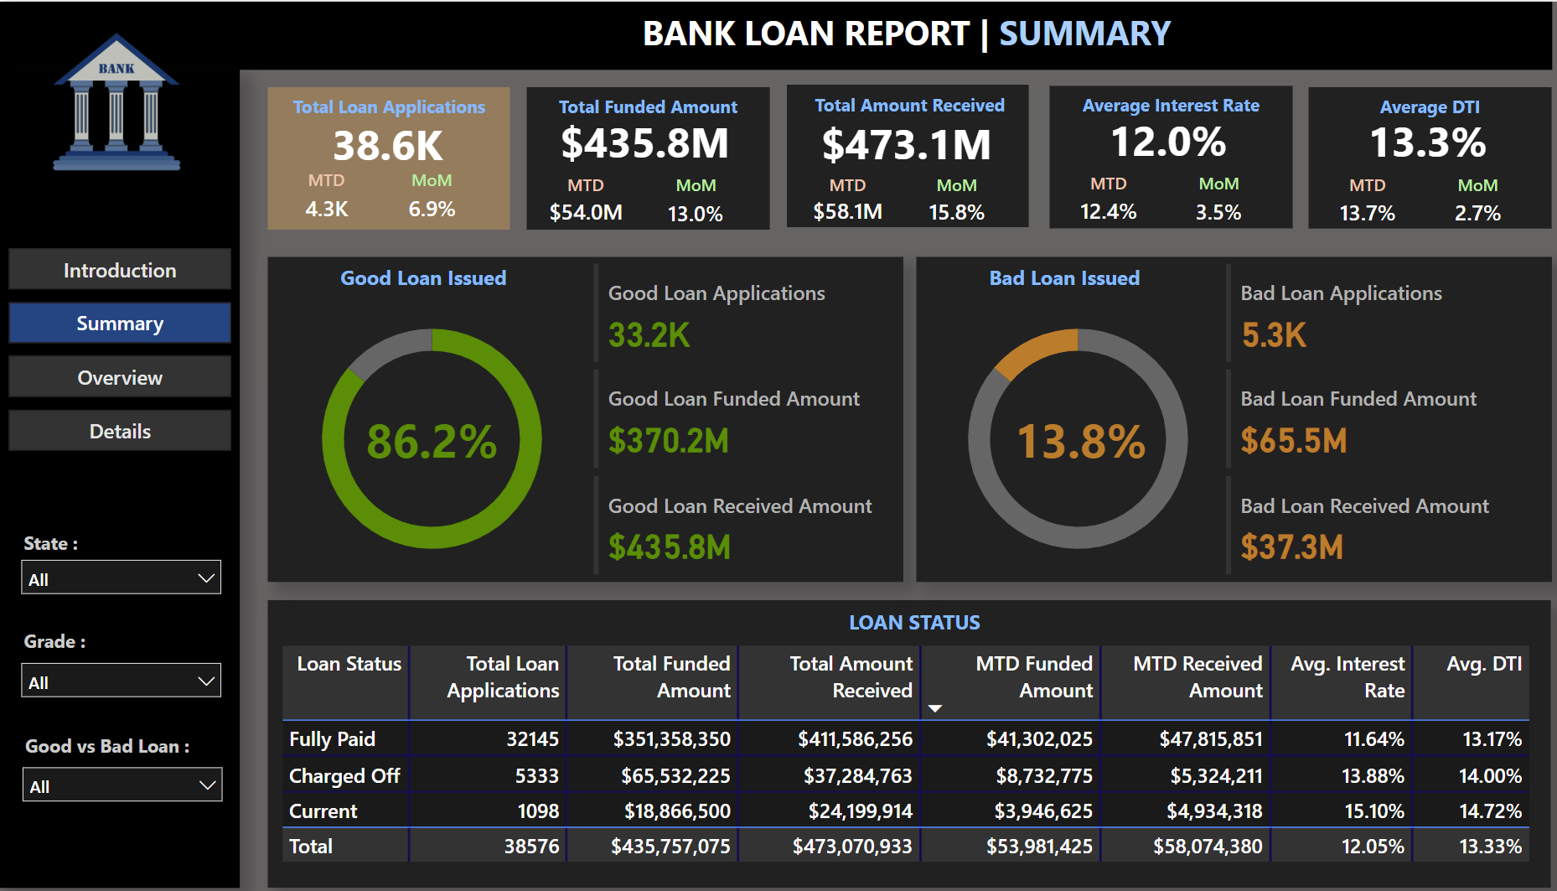
Dashboard Snapshot

Slide 9




How to Use the Dashboard
Open File
Load bank_loan_data_insights.pbix in Power BI Desktop.
Apply Filters
Explore loan status, demographics, and loan risk factors.
Analyze Patterns
View distributions by geography, income, and loan purpose.

Slide 10

Conclusion & Next Steps
Data-Driven Decisions
Risk Identification
Effectively identifies high-risk applicants and approval drivers.
Dashboard enhances loan processing accuracy and efficiency.
Strategic Impact
Supports informed strategies within loan departments.

